Slide 1

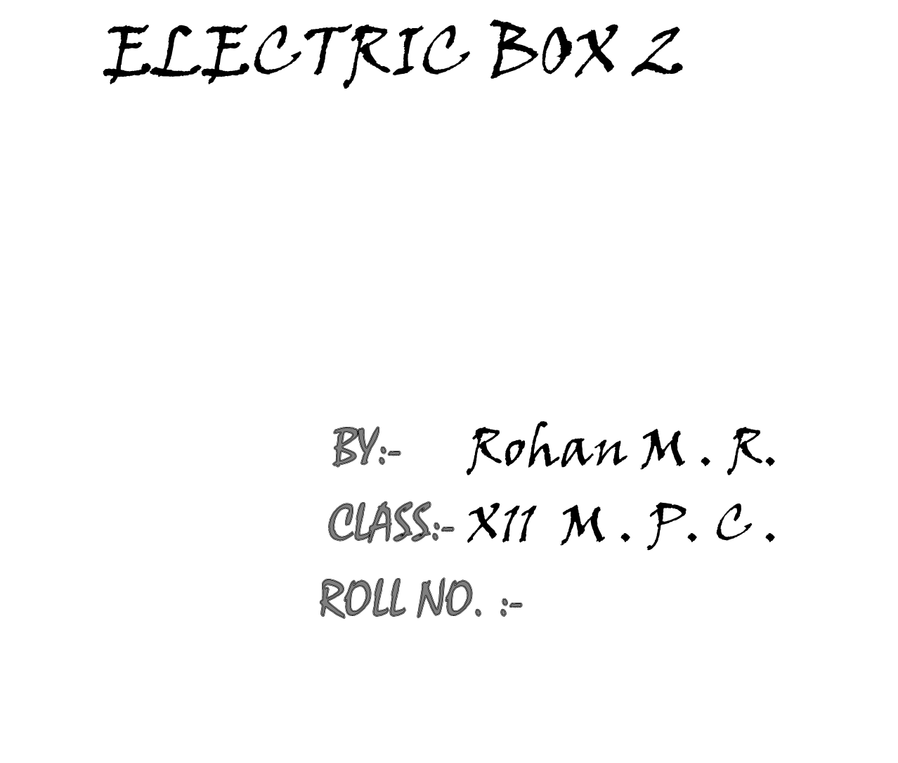
COMPUTER SCIENCE PROJECT

Slide 2
ACKNOWLEDGEMENTS
Firstly, I would like to thank BHAGWAN SRI SATHYA SAI BABA, without whose will , I would not be able to even do this project.
I would then like to thank my parents and uncle who supported me in this project.
Then I would like to pay my heartfelt gratitude to my C++ teacher, Mr. Venkateshwar Prusty, who constantly guided me during this project.
Then I would like to thank our principal Mr. Shivaramakrishniah, for his support and encouragement.
Last but not the least, I would thank my fellow brothers Satya siddarth, Rohan .S, Sanjay, Rishi Rao ,D Sai Shyam, Varun Guru Raju, P Sai Praneeth, Aadithya Dinesh , Nishant Tomar, Vishwanadh, Shridhar K. M., Sreekar, Sirish.S,
Suhas Reddy and Rahul Gireesh who were my constant companions while doing this project.

Slide 3
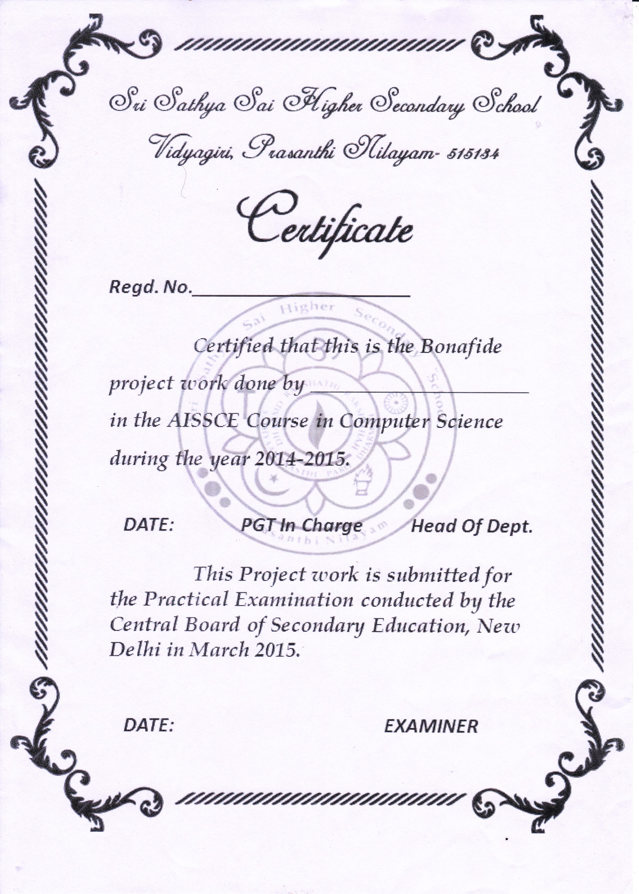
ROHAN MOHAN RAYARADDI

Slide 4

To simulate a logical game, “Electric Box 2” using c++.

Slide 5

The latest, fastest developing industry which captivates most people today is the gaming industry. There is a lot of craze for games now a days, which has also increased the enthusiasm of the programmers who develop these games .
One such game which was developed is electric box 2.It was such a popular game on PC, that it was made even for android and iPhone.
I too have tried to make a small version of this game. It is a very interesting game which requires the combined skills of logic and expertise to play, giving the player a thrilling experience.

Slide 6

The basic objective of the game is to take current from the source to the target. But unlike other similar seeming games where you have wires or similar stuff of different sizes and shapes to meet the objective, surprisingly here you have different objects, day-to-day objects to do the task, giving it the extra flavour of unusualness and interest.
Although these things can not be done at the actual macro level, they have a resemblance to the natural phenomena. For example, a bulb when given power, produces light, however this light would not be sufficient for a solar panel to produce electricity. However , here we have used the fact that bulb gives light and solar panel converts light to electricity to achieve the goals of the game.
This analogy can also be extended to a fan which produces air, and a generator which produces current using the mechanical energy of the air. Same is the case with a kettle dropping water and a generator.
The aim of making this game is to make you think as to how to use all the possible objects to achieve the objective of the game.
The wires are fixed and you can not move them. You can only move the various objects which you have such as solar panel, bulb, fan, generator, kettle(to drop water), pullerbot, pusherbot, wall which you can use to achieve the objective.

Slide 7
The objects can be picked from the inventory below by left clicking the mouse and can be put into a box by right clicking the mouse. The main source of current is the power button. No object can be moved when the power is switched on.
There are five levels in this game. Each level introduces a new object and involves a different logic to solve. There is also a tutorial available which gives the player a good understanding of the game. This tutorial can be switched on and off as wished by the player, but it is advised to leave it on as it would be necessary for the understanding of the game.
There are some special objects in the game like the pusherbot and the pullerbot which can be used to move the objects while the power is switched on.
There is also an option to return to the main menu in the middle of the game, the player can either return back to the same place or can restart the game.

Slide 8

As you have already seen that this game has a lot of real world objects, hence it is implemented using object oriented programming.
The basic layout of the game is a grid with blocks. These blocks are the objects of the class block
The class definition is as follows:
class block{
char obj,obj1;
int p,x,y,f,l,a,w;
public:
void val(int a,int b);
void put(char ob,int f1=0);
block();
int retx()
{return x;}
int retf()
{return f;}
int rety()
{return y;}
int reta()
{return a;}

Slide 9
int retl()
{return l;}
int retp()
{return p;}
int retw()
{return w;}
char retobj()
{return obj;}
char retobj1()
{return obj1;}
void getp(int s);
void getl(int s);
void geta(int s);
void getw(int s);
void getobj(char s);
void getobj1(char s);
}bl[50][50];
. The class has many variables which determine all the characteristics of all the blocks such as the x,y coordinates of the blocks.
The other variables include obj and obj1 which hold symbols of the present object in the block and the fixed object(if any) of that block respectively. There are also ‘p’, ’a’, and ‘w’ variables which correspond to power, air and water respectively, that is if current flows through that block the ‘p’ variable will be in the on state, similarly the ‘a’ variable will be in the on state if air flows through the block and same with ‘w’ if water falls through that block.

Slide 10
The class also has a function ‘put’ which puts the object mentioned in that block taking care if the block is empty or not. This gives the advantage of not needing to know the coordinates of the blocks each time.
The program also has structures defined for each of the ‘objects’ to store their x,y coordinates. These are used to know where the object is at that moment.
There are apart from these, many functions which do each object’s work. These functions are “didgeneratoroff”, “didgeneratoron”, “isbulbon”, “didsolarpaneloff”, “didsolarpanelon”, “isbulboff”, “isbuton”, “isfanoff”, “isfanon”, “iskettleoff”, “iskettleon”, “ispullerboton”, “ispusherboton”.
Some of these functions like “didgeneratoron”, “didsolarpanelon” switch on the wires and objects connected to them if they are true ,and functions like “didgeneratoroff”, “didsolarpaneloff”, switch off the same.
Others like “isbulbon” sends light to the blocks up, left, down , right till it finds an object, “isfanon” sends air in the direction it is facing till it finds an object, “iskettleon” pours water downward till it finds an object, “ispullerboton” moves the pullerbot forward till an object and pulls it backward, “ispusherboton” moves forward and keeps pushing the object in front of it till it is blocked.

Slide 11
Conversely “isbulboff”, “isfanoff”, “iskettleoff”, do the opposite.
The other functions are “level1”, “level2”, “level3”, “level4”, “level5”, which fix the initial positions of the objects and wires in their respective levels. The “pickup” function picks up the object in the block if it is possible to do so. The ”putobj” function puts the picked up object in the block clicked and the “putinfo” function puts the information of the object in the information box if the mouse is over the object.
Smaller functions are “checkbox” which checks the number of the box clicked, ”checkpow” which checks if power is on, “intr” displays the introduction and “mainmenu” displays the main menu at the end of introduction, “init” initializes graphics, ”fontinit” initializes fonts and “deinit” deinitializes them, the “onn” function displays the moving images of objects.
In this way the entire program is well modulated into various different functions to handle the various different works done in the program.

Slide 12

The actual version of the game comprises of over 50 levels. I have implemented four from there, and added a level of my own, implementing all of them would be a great challenge and a worthy endeavour. There are many more objects available in the actual game, which if added, would make it more interesting.
The concept of “threading” can be implemented using the latest versions of allegro, which enables you to do parallel processing. With the help of this many more things can be achieved which were not done in this project.

